Slide 1
RUNGTA COLLEGE OF DENTAL SCIENCES & RESEARCH
Oral mucous membrane
DEPARTMENT OF ORAL PATHOLOGY

Slide 2
OBJECTIVES
DEFINITION OF ORAL MUCOUS MEMBRANE
FUNCTIONS OF ORAL MUCOUS MEMBRANE
ANATOMICAL CONSIDERATION
COMPONENTS OF OM
ORAL EPITHELIUM
EPITHELIUM PROLIFERATION
EPITHELIUM MATURATION

Slide 3
CONTENTS
DEFINITION OF ORAL MUCOUS MEMBRANE
FUNCTIONS OF ORAL MUCOUS MEMBRANE
ANATOMICAL CONSIDERATION
COMPONENTS OF OM
ORAL EPITHELIUM
EPITHELIUM PROLIFERATION
EPITHELIUM MATURATION

Slide 8
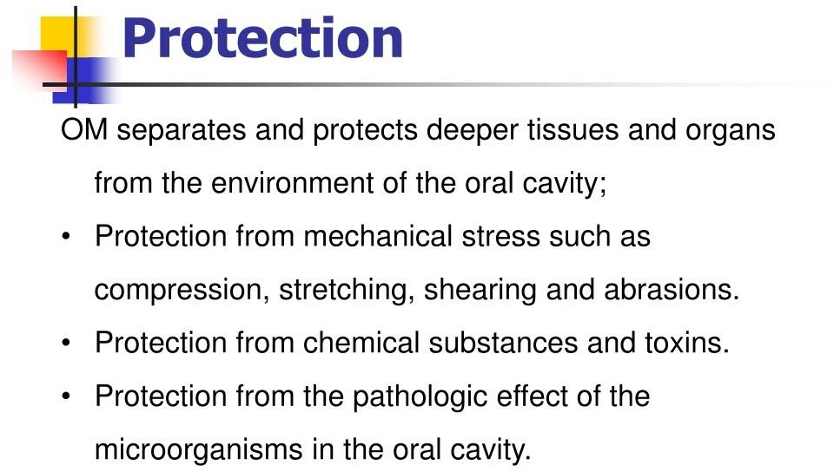

Slide 10
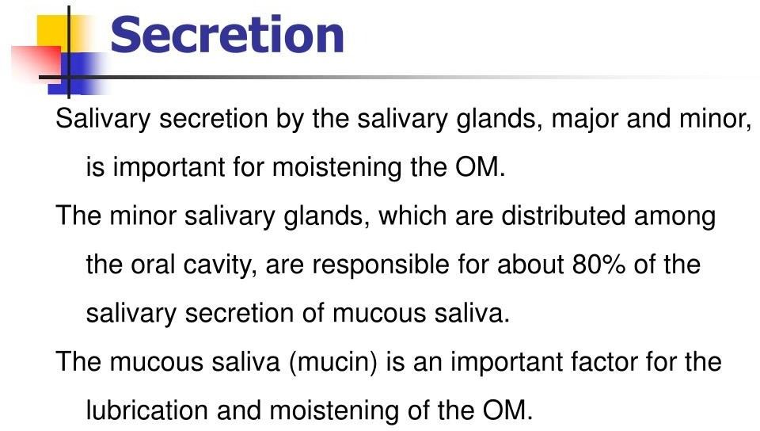

Slide 11
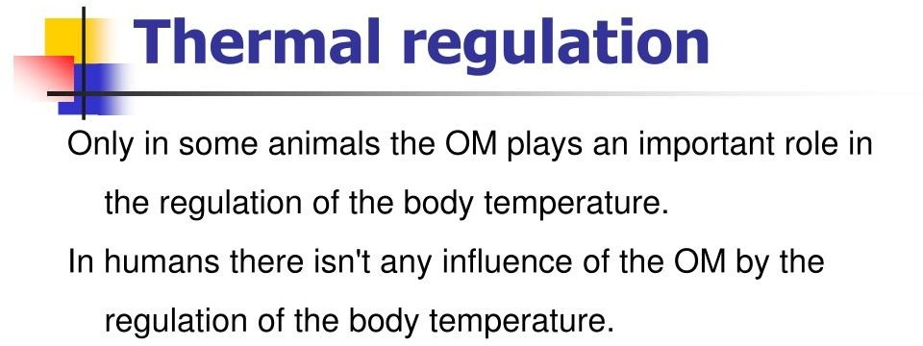

Slide 14
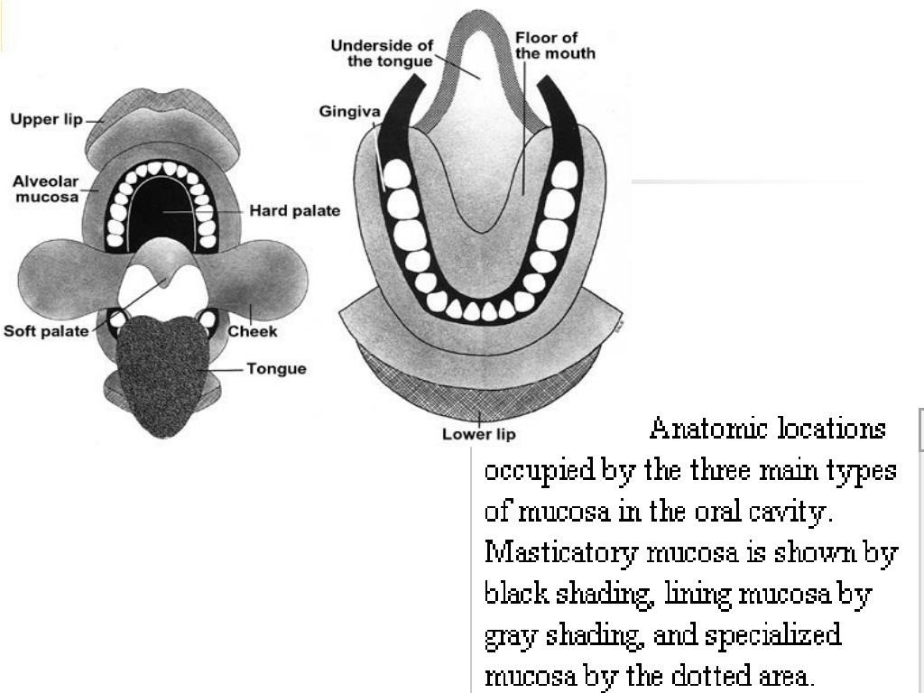

Slide 16
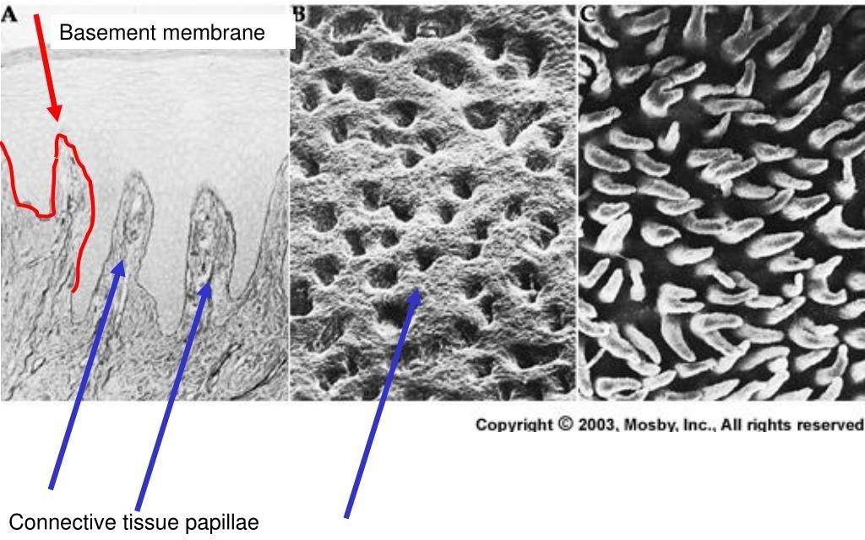

Slide 18
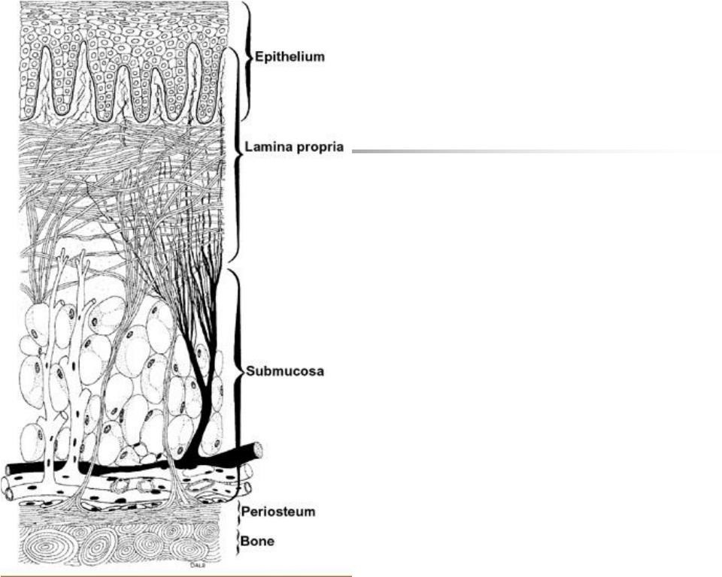

Slide 20
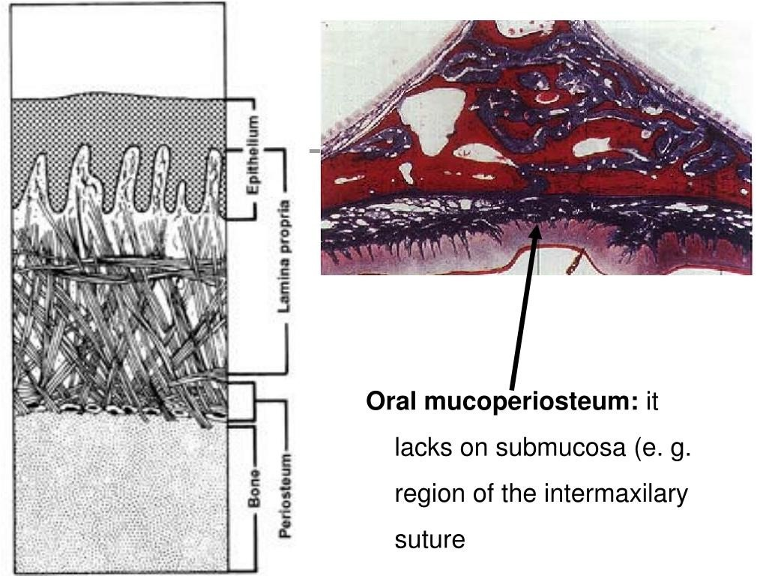

Slide 25
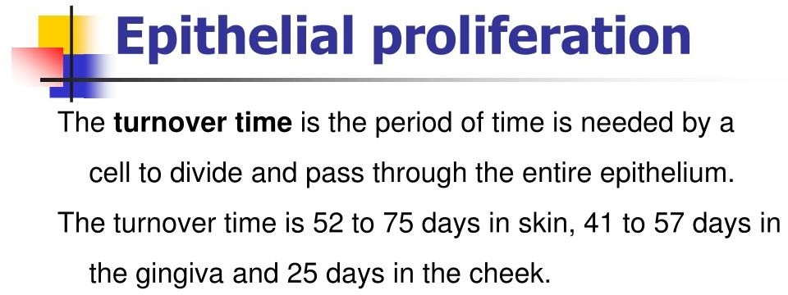

Slide 33
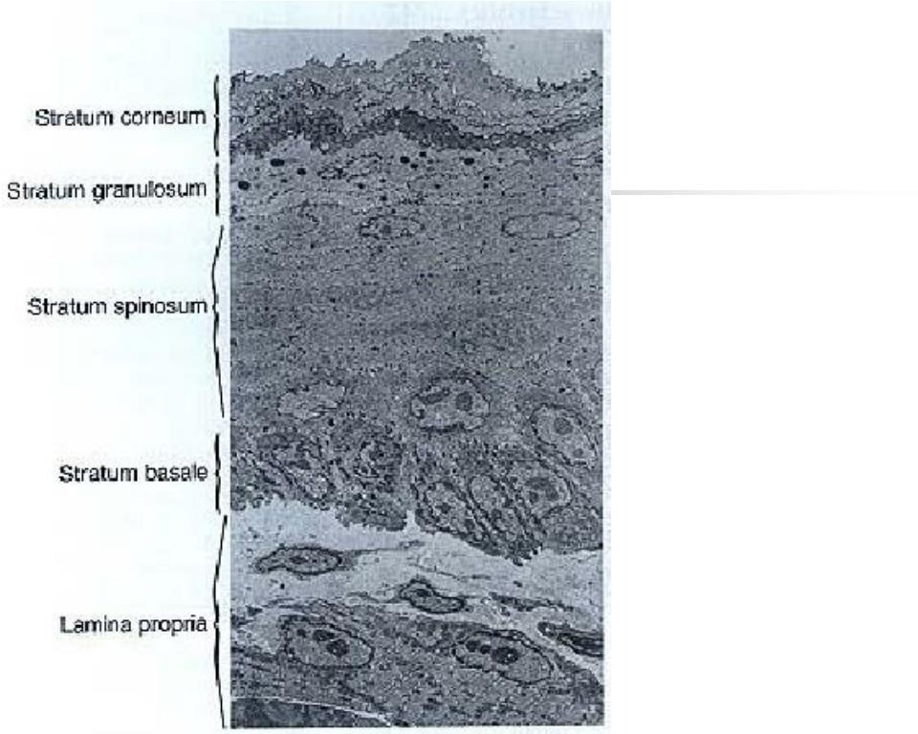

Slide 37
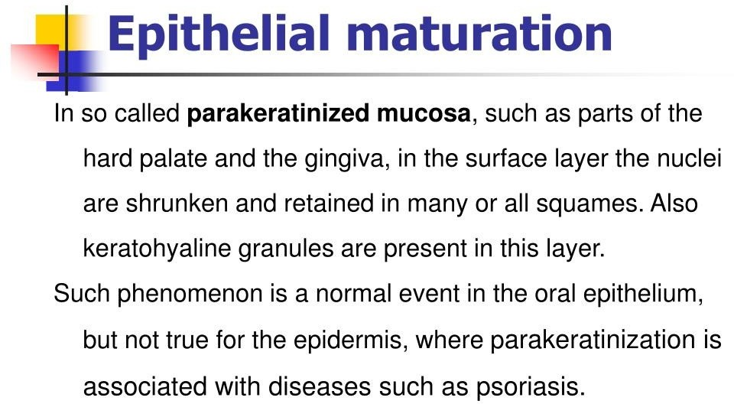

Slide 39
SUMMARY
Oral mucous membrane maintains the integrity of the oral cavity in health and disease. Knowledge regarding the mucosa aids in detecting any changes from normalcy which would pave the way for diagnosing various disorders which affect the mucosa & thus providing treatment for the same. Also as public health dentists educating people regarding detection of changes in the mucosa.

Slide 40
Take home message
Oral mucous membrane maintains the integrity of the oral cavity in health and disease. Knowledge regarding the mucosa aids in detecting any changes from normalcy which would pave the way for diagnosing various disorders which affect the mucosa & thus providing treatment for the same

Slide 41
Question & Answer Session
FUNCTIONS OF ORAL MUCOSA
COMPONENTS OF ORAL MUCOSA
FEATURES OF KERATINIZED & NON-KERETINIZED EPITHELIUM

Slide 42
References
SN Bhaskar . Orban’s ,Oral Histology and embryology. 11th edition, Mosby 1998
Neville BW ,Damm DD ,Allen CM ,Bouquot JE . Oral and maxillofacial pathology , 2nd Edition .Philadelphia W.B. Saunders ;2002
Richard Tencate , Oral Histology development ,structure and function . 5th Edition ,1998
Carranza F.A., Michael G. Newman . Clinical periodontology 8,9,10th edition

Slide 43
THANK YOU

